Slide 1
Annotation base Configuration

Slide 2
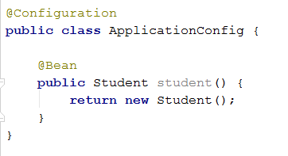
Spring Annotation Base
Support creating the Spring configuration not use XML

Slide 3
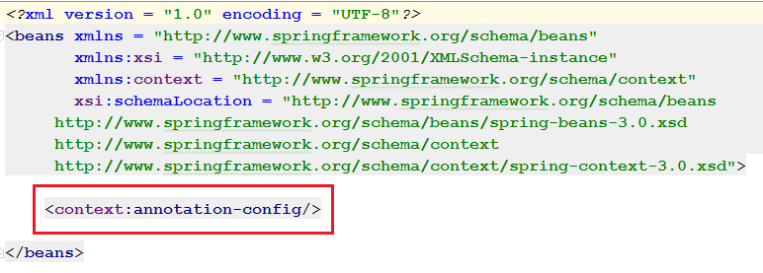
Spring Annotation Base
By default Spring Annotation is turned off -> turn on before using

Slide 4
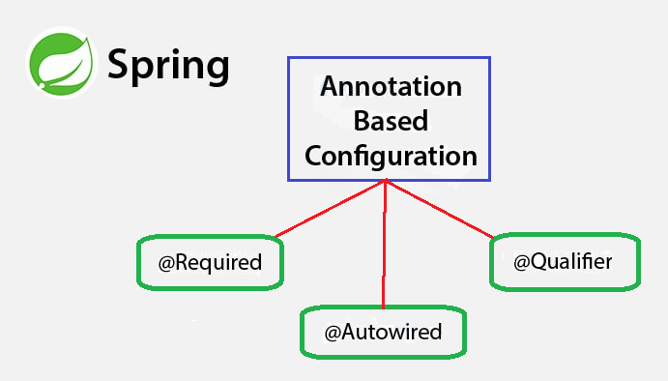
Some important annotation
@Required
@Autowired
@Qualifier

Slide 5
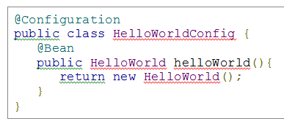

Example Annotation- @Configuration & @Bean
The above code is equivalent to the following XML content

Slide 6
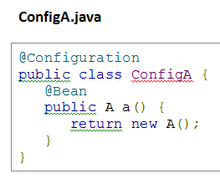
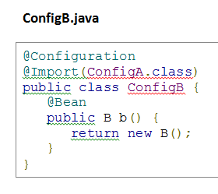
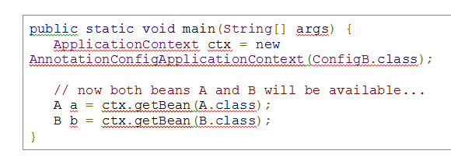
Example Annotation- @Import

